Slide 1
Innovation for fun and profit
Marty Gauvin
Project Calrissian

Slide 2
Outline
Innovation – my experience
A broader Australian perspective
Components of Innovation

Slide 3
My background
St Peters College
Unusual opportunities
GCL Systems
Virtualised MS-DOS
Dataview for legally blind people
Parseq Computer Systems
School/Campus networks and multimedia
Childhood immunisation system

Slide 4
Ngapartji
Cooperative Multimedia Centre – Rundle Street
Hostworks
Successfully developed an innovative AU company which has put us on the map
70 customers including Microsoft, ninemsn, Ticketek, Seek, ING, American Express, Jetstar.
20% of Australian web page views
Bought for highest multiple since the tech boom of 2001

Slide 5
The Government view
Spent the last 8 years working with Innovation Australia on about 70% of their programs that support industry
Was involved in the review of the national innovation system last year – a Government response is due in the budget

Slide 6
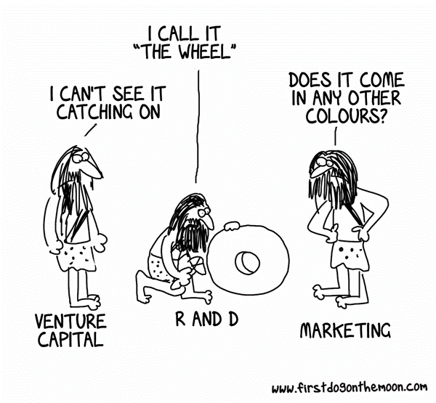

Slide 7
Australia's Innovation System
Federal Government
National Health and Medical Research Council
Universities
Industry
Australian Research Council
Co-Operative Research Centres
Innovation Australia
Industry
State Governments
CSIRO
Notes:
Only since 1984 has AU had anything like an innovation policy
Innovation is supported based upon
Management Team
Technical Strength
Commercial Strength
National Benefit
Need for support

Slide 8
Innovation Australia
Innovation Australia Board
Commercial Ready (now cancelled)
Innovation Investment Funds (VC)
Commercialising Emerging Technology
Industry Cooperative Innovation Program
Cooperative Research Centres
Early Stage Venture Capital Limited Partnerships
A wide range of programs are managed by Innovation Australia and delivered by AusIndustry. Many of these may become more suited to use by schools in the next iteration.
Innovation Australia has ten committees that each manage a collection of programs. I’m presently on two of them and have been on three.

Slide 9
Review of the National Innovation System
I was a member of the CRC and collaboration working group chaired by the NSW chief scientist (and former University of Adelaide Vice-Chancellor) Professor Mark O’Kane.
NIS Review Panel
Collaboration and CRC
Mary O’Kane
Marty Gauvin
Tom Healy (ARC)
Warwick Anderson (NH&MRC)
Megan Clark (CSIRO)
Inter-Governmental
Tax and R&D Tax Concession

Slide 10
Australian Government Expenditure on Science and Innovation
Source: Venturous Australia, 2008

Slide 11
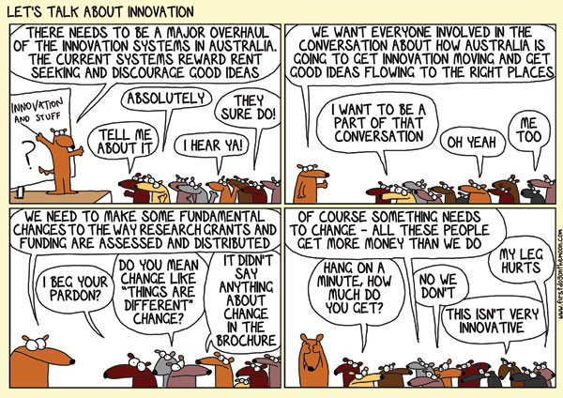

Slide 12
The process of innovation
origination or adaption
KNOWLEDGE PRODUCTION
deployment
KNOWLEDGE DIFFUSION
KNOWLEDGE APPLICATION
diffusion and absorption
Source: Terry Cutler

Slide 13
Industry Programs
Government programs have typically been aimed at addressing ‘market failures’. They are measured against criteria of additionality, efficiency and appropriateness.
The recent shift in the policy view, as well as government budgetary issues are having a significant effect.
Source: AusIndustry

Slide 14
The essential collaboration
Innovator
Leader
Implementer
Administrator/Manager
Service Providers
Service Providers
Facilitators/Parasites
Service Providers

Slide 15
Broader Collaboration builds the effect
Innovator
Innovator
Leader
Implementer
Leader
Implementer
Administrator/Manager
Administrator/Manager
The benefits of collaboration to improve outcomes have been demonstrated in all circumstances. The increased benefits of International collaboration is what the NIS review sought.

Slide 16
The Risk Gap
Anecdotally, lower levels of innovation come with higher levels of ‘comfort’ in society. Comfort leads people naturally to take fewer risks.
Risk is a natural and necessary element to innovation.
The Risk Gap is the gap between what the innovator is prepared to take on themselves (which can be increased by higher rewards or lower ‘comfort’) and what is required to bring the innovation to fruition.

Slide 17
Classes of Risk
Technical Risk
Generally ‘what if this idea doesn’t work’. The ‘R’ in R&D.
Commercial Risk
Commercial Return
Access to Market
Marketing/Sales and matching supply to demand
Competitive Risk
IP Protection
Time to market
Collaboration Risk
Can we do something better (more effective, quicker, lower cost) working together?
Can we share the spoils? Agreements
Can we work together (alignment - culture, objectives, etc)
Market Risk
Is the need there?
Can we identify the market for this need?
Will/can anything change in this market?

Slide 18
So who are the innovators?
People who can get
the idea
the time
the team
the resources
that they need.
People who can overcome the fear of failure. (environment/experience)
People who are following their passion.

Slide 19
What's Next
For Me
Project Calrissian
The idea
The business model
The funding
The team
For the Innovation System
White paper
Budget
New opportunities!

Slide 20
Questions

