Slide 1
Human Ingenuity,ethics and the articulation between MYP & DP
AAIBS Conference Adelaide
April 2009
Roger Marshman

Slide 2
The 2002 Adelaide Challenge
What has the MYP to say about values?
Implication of constructivism
  Marshman, R. (2005). Constructivism, values and the IB continuum. Paper delivered at IBAEM Regional Conference, Athens.
The trend towards explicitness in AoIs since 2002
Development and adoption of the LP since 2002

Slide 3
Learner Profile should be
Page 3
Non absolutist
Non fundamentalist
Constructivist
Not relativist either – others can also be wrong
Antithesis of some approaches to “Character Education” – see Alfie Kohn: How not to teach values

Slide 4
Today’s points of focus
“… others with their differences can also be right” ; a pluralist not monist perspective
Human Ingenuity (as an MYP Area of Interaction) in its concern with ethics
Two aspects (but could be others) of the learner profile:
  Thinkers
  Reflective
Getting to ToK: knowledge claims in values and ethics

Slide 5
ToK: problems to be raised
Values: Ethics of rewards and notions of authority
Truth claims in cultural/religious behaviour
Remembering claimed centrality for IB of
  Intercultural Awareness
  International mindedness

Slide 6
Approaches to learning
How do I learn best?
How do I know?
How do I communicate my
understanding?

Slide 7
Are these the key questions?
What are my values?
Where have they come from?
How are they
  Challenged?
  Defended?

Slide 8
An ATL aside: Sept 2005
Other possible G Qs
What other strategies could I use?
In what ways can I learn about this?
Is there another view?
What values do I bring to this task?
How independent can I be?
How can I claim to know?
Think: What am I aiming for? Act: How will I do it? Reflect: How successful have I been? By what measure?

Slide 9
A common thread in all this?
The R word
  for better of for worse?

Slide 10
The R word: reflection
“Thinking about what you are doing”
“Treacle; a confusing morass of meanings”
“triumph of reason and science over instinct and feeling”
“the consecration of emotion and feeling”

Slide 11
Is this what we do?
“By making every teacher and student the unchallenged arbiter of his or her own achievement, reflection dovetails neatly with progressive education’s preference for process over content and with the confessional, therapeutic strain of American culture.”
        Samuel Freedman, NY Times, 30 August 2006

Slide 12
Reclaiming the R territory
Yes we can
Yes we need to
The MYP Planner is a significant tool
We will return to this later in the presentation

Slide 13
Human Ingenuity
Understanding the evolution, processes and
products of human creation
Appreciating human capacity to impact life
through creation, innovation, development and
transformation
Exploring relationships between ethics,
science, aesthetics and technology.
Notes:
Homo faber involves questioning, explaining, discovering, and doing. The
involvement of the students in the creative processes results in the
recognition of impacts and consequences.
Homo faber involves all subject groups in different ways as it encourages
students to see the relations between science, aesthetics, technology and
ethics.

Slide 14
Human Ingenuity
Why and how do we create?
What are the consequences?

Slide 15
Human Ingenuity
Added focus on values:
Where does the power lie?
By what values were the famous thinkers motivated?
What might the future hold?
What is the truth?
How do I know what is right?

Slide 16
Relativism? Absolutism?
“…can also be wrong”
Focus is squarely on the fundamental concept of intercultural awareness
Increasing use of “pluralism”
Shift from understanding of “culture” and cultures to engagement with cultures
IB Founders’ emphasis on peace studies

Slide 17
LP as Character education?
What could possibly be wrong with that?
Can we legislate for affective outcomes?
Copybook Nazis?
Alfie Kohn warns of the implicit dangers of absolutism and good intentions
And we’ll take a look at pluralism

Slide 18
Alfie Kohn: How not to teach values
A Critical Look at Character Education, Phi Delta Kappan, February 1997
*Or “how not to teach the Learner Profile” ?

Slide 19
Kohn’s 2 meanings of Character Education
Broad sense: all we do to help “children grow into good people”
Narrow sense of particular moral training
The language must be reclaimed, not surrendered to
  Behaviourists
  Conservative ideologues
  Religious absolutists or notions of “Fix the kids”

Slide 20
Masquerading Monism
Mistaking good behaviour for good character
Prizing docility, suggestibility
Extrinsic rewards (and artificially limited awards) become the motivation for what is judged by someone else as “good”.

Slide 21
Indoctrination
Drilling students in specific behaviours rather than engaging them in deep, critical reflection about certain ways of being. (See Kohn P1-2)
Programmed instruction: It’s Tuesday. This must be honesty.

Slide 22
“Forest of Virtue” approach
“The virtues themselves are not open to debate, the headmaster insists, since moral precepts in his view enjoy the same status as mathematical truths” (P2)

Slide 23
Constructivist stance & LP
Schools as social systems and existing within social systems
Versus
Fix the basically evil child

Slide 24
Kohn’s 5 basic questions
At what level are problems addressed?
What is the underlying theory of human nature?
What is the ultimate goal?
Which values are promoted?
How is learning thought to take place?

Slide 25
1. At what level are problems addressed?
Fix the kids or transform schools and classrooms?
Importance of social contexts
“Fundamental attribution error” (a social psychology term)

Slide 26
2 What is the underlying theory of human nature?
Fundamental selfishness
War between desire and reason
Character seen as “capacity to control impulse and defer gratification”
Or that children are equally potentially moral as empirical studies suggest

Slide 27
3 What is the ultimate goal?
Social conservatism or “helping children become active participants in a democratic society…” (p.5)
Which traditions are worth preserving? Why?
(A possible aside on national curricula…here or later.)

Slide 28
4 Which values are promoted?
Whose? Cui bono?
Unquestioning obedience or compliance seen as virtuous?
Glasser: “…many educators teach thoughtless conformity to school rules and call the conforming child responsible”
Empathy and scepticism as worthy contenders?
Self determination as much as self control?
Which senses of “authority”?

Slide 29
5 How is learning thought to take place?
Kohn claims that telling and compelling is still accepted in the values arena by some who reject the model in academic subjects.
  Demand compliance
  Advertising approaches
  Multiple choice answers
  Directed discussion
Constructivism requires reinvention
Adults as models

Slide 30
LP is not absolutist
Neither is the values perspective entailed in AoIs
BUT it is not moral relativism (mere apathy?)
Possibility of “universal values” as distinct from “universalism”
(Kant’s duty-full categorical imperatives? A ToK question for another day!)
Notes:
Universalism is monistic/fundamentalist in worst sense. I am right, so you must be wrong
Kant: Duty, Motive over consequence

Slide 31
Isaiah Berlin on Pluralism
I came to the conclusion that there is a plurality of ideals, as there is a plurality of cultures and of temperaments. I am not a relativist; I do not say "I like my coffee with milk and you like it without; I am in favor of kindness and you prefer concentration camps" -- each of us with his own values, which cannot be overcome or integrated. This I believe to be false. But I do believe that there is a plurality of values which men can and do seek, and that these values differ. There is not an infinity of them: the number of human values, of values that I can pursue while maintaining my human semblance, my human character, is finite -- let us say 74, or perhaps 122, or 26, but finite, whatever it may be. And the difference it makes is that if a man pursues one of these values, I, who do not, am able to understand why he pursues it or what it would be like, in his circumstances, for me to be induced to pursue it. Hence the possibility of human understanding.

Slide 32
These quotations
Are from the last essay written by Isaiah Berlin
Berlin, I. (1998). The first and the last (extract). New York Review of Books, 45(8).

Slide 33
Berlin again
If pluralism is a valid view, and respect between systems of values which are not necessarily hostile to each other is possible, then toleration and liberal consequences follow, as they do not either from monism (only one set of values is true, all the others are false) or from relativism (my values are mine, yours are yours, and if we clash, too bad, neither of us can claim to be right).

Slide 34
Diana Eck: Harvard Project on Pluralism
Energetic engagement with diversity (not mere recognition)
Active seeking of understanding across the lines of difference ; “tolerance is too thin a foundation for a world of religious difference and proximity”
Encounter of commitments (not relativism)
Based on dialogue: “being at the table with one’s commitments”
www.pluralism.org
Notes:
What Sacks explores as the importance of Conversation
The devil is in the detail!! Easy for religions to agree on some of the big picture items.

Slide 35
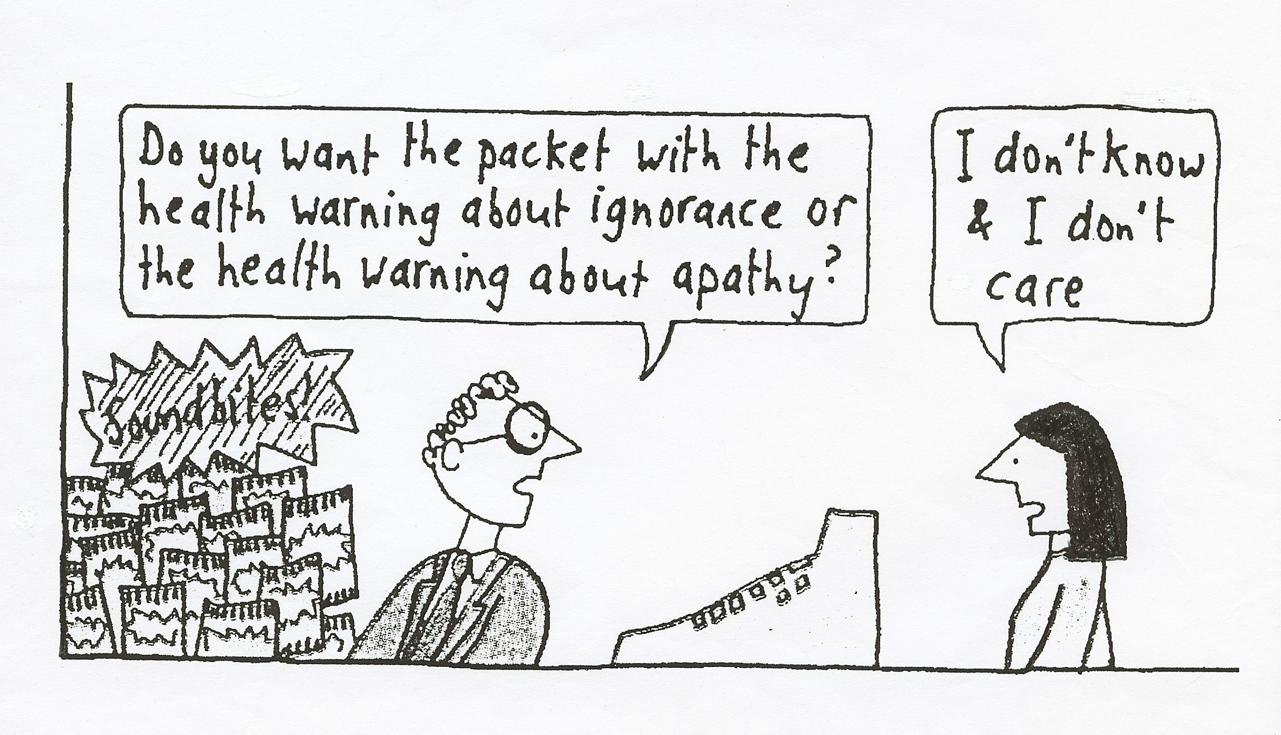
Brilliant Horacek
Page 35

Slide 36
Sacks: The Dignity of Difference
  Two views of fundamentalism:
    A positive response to the excesses of the sixth universalist danger: global market capitalism
    Or new introverted tribalism: “talking to your own”
    (And he has a shot at Plato and the idea of universal truth)
  The importance of particularity and celebration of difference
  There can be more than one moral truth

Slide 37
HH the Aga Khan
“The downside of globalization is the threat it can present to cultural identities.
“But there is also a second great challenge which is intensifying in our world …a growing tendency toward fragmentation and confrontation among peoples. In a time of mounting insecurity, cultural pride [and] the quest for identity can then become an exclusionary process - so that we define ourselves less by what we are FOR and more by whom we are AGAINST. When this happens, diversity turns quickly from a source of beauty to a cause of discord.

Slide 38
New globalism & new tribalism
“the coexistence of these two surging impulses - what one might call a new globalism on one hand and a new tribalism on the other - will be a central challenge for educational leaders in the years ahead.
And this will be particularly true in the developing world with its kaleidoscope of different identities.”
        Khan, A. J. (2008). Global education and the developing world. International Baccalaureate Organization Peterson Lecture, April 2008.

Slide 39
Market Values vs Ethical Values (Geller)
Are the values of the LP universal?
Globalization: “…the establishment of price as the only criterion [of value]” (Geller p. 33)
Has there been reluctance of educators to express moral values ?
Truth, fairness/justice, trust, compassion : the values of the ethics of not harming others
Happiness characterised by peace (Dalai Lama)
Importance of historical perspective in learning
Page 39

Slide 40
Reclaiming the R word
The well deserved bad name…
But we’ve grown beyond that, haven’t we?
MYP planner expectations not met yet.

Slide 41
Reflection
Critique
Evaluation
Analysis

Slide 42
The worthwhile
Can be
  Within summative tasks
  Within teaching/learning tasks
  Subject of formative feedback
  Stand-alone reflective tasks
  Focused on specific thought processes thus linking with ATL

Slide 43
Prompts for the worthwhile
Extension/alteration to my position through challenge or confirmation
  HOTS of comparison, analysis, synthesis
What action has this led to, will this lead to?
How will I know when I have engaged?

Slide 44
Service Learning rubric ?
Possible headings/criteria
  Challenge
  Benefit to others
  Acquisition of skills
  Initiation and planning by students
  Establishing links with the community
  Commitment
  Reflection

Slide 45
Initiation and planning by students
(example)
One school’s highest descriptor:
planned, organised and run by student(s); requires active participation and input from student; plans reflect the needs of the community

Slide 46
Reflection (example)
One school’s highest descriptor
Reflections demonstrate empathy, respect, self-awareness and a degree of humility

Slide 47
Weaknesses in application of MYP planner
Identification of AoI and subsequent emphasis in phase 2
Focussed and skilled reflection tasks (a teachable and learnable skill)
ATL: vagueness especially in terms of HOTS
(A personal and current view)

Slide 48
Habits of mind
Kohn’s distinction of constructed from mere…
Indoctrination
Clarity, accuracy and restraint of impulsivity (ASCD)

Slide 49
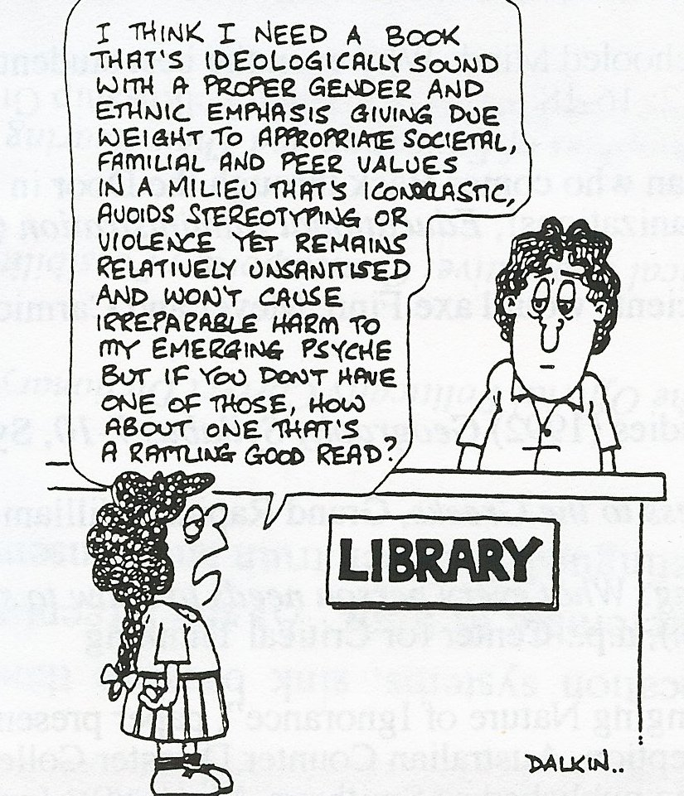
PC ?
Notes:
Nor is the alternative orthodoxy of PC the answer!

Slide 50
The enemies
Globalization
Monism
Fundamentalism ( AK’s new tribalism?)
Relativism (apathy?)

Slide 51
Aga Khan “strands”for curriculum construction
Pluralism
Ethics
Global economics
Muslim civilizations
Civil society
Somewhat analogous to the Areas of Interaction

Slide 52
What are my values ?
Standard A2.4: The school encourages student learning that strengthens the student’s own cultural identity, and celebrates and fosters understanding of different cultures.
Notes:
Two Melbourne schools
Implications for challenging and supporting

Slide 53
Kurt Hahn (Peterson 1987)
(not just) the power to think….
but the will to act
An explicit expectation of learning: successful inquiry will lead to responsible action

Slide 54
In summary… the Learner Profile requires
Engagement with rather than knowledge about

Slide 55
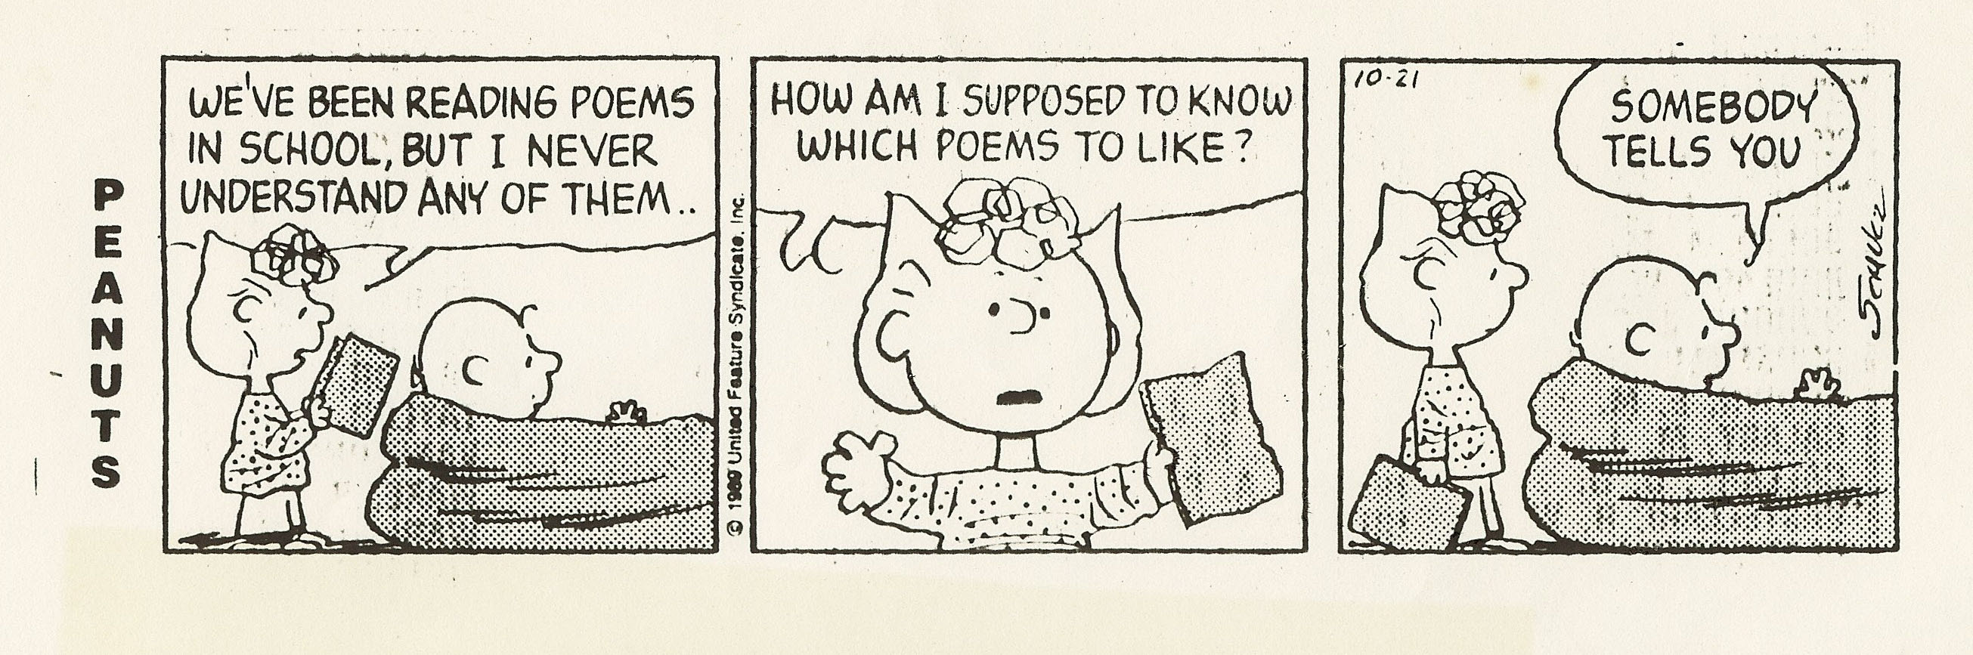

Slide 56
Time for reflection!
Unhappy is the land that needs a hero (Brecht)

Slide 57
ToK
Did the DP actually get there first?
Truth claims
Perceptions both sensory and cultural
Emotional knowing
Ethical systems eg Kant and categorical imperatives

Slide 58
Useful References
Berlin, I. (1998). The first and the last (extract). New York Review of Books, 45(8).
Boix-Mansilla,V., & Gardner, H. (2007) From teaching globalization to nurturing global consciousness. In M. Suarez-Orozco (Ed.), Learning in the global era. Berkeley: University of California Press.
Chapter 1 Prologue. In J. Sacks (2003). The dignity of difference. London: Continuum International Publishing Group.
Khan, A. J. (2008). Global education and the developing world. International Baccalaureate Organization Peterson Lecture, April 2008.
International Baccalaureate Organization (2008). MYP: from principles into practice. Cardiff: International Baccalaureate Organization.
International Baccalaureate Organization (2006). IB learner profile booklet. Cardiff: International Baccalaureate Organization.

Slide 59
And some more…
Kohn, A. (1997). How not to teach values. Phi Delta Kappan 76(6), 429-439.
Marshman, R. (2005). Constructivism, values and the IB continuum. Paper delivered at IBAEM Regional Conference, Athens.
International Baccalaureate Organization (2008). Toward a continuum of international education. Cardiff: International Baccalaureate Organization.

Slide 60
Additional References
Peterson, A D C (1987) Schools across frontiers – the story of the International Baccalaureate and the United World Colleges, Open Court, La Salle, Illinois
Eck, D (2006) What is pluralism? Harvard Project on Pluralism www.pluralism.org Accessed 15 April 2007.
Gellar, C.A. (2002). International Education: a commitment to universal values. In M. Hayden, J. Thompson, & G. Walker (Eds.), International education in practice. London: Kogan Page.
Hill, I. (2002) The history of international education: an International Baccalaureate perspective. In M. Hayden, J. Thompson, & G. Walker (Eds.), International education in practice. London: Kogan Page.

Slide 61
Thank you
r.marshman@internode.on.net

